Slide 1
Basic Logics

Slide 2
Review
A variable is a name referencing to a memory location.
A data type defines: How the values are stored and how the operations on those values are performed.
4 primitive data types in C: int, char, float, double
Data stored are in binary format
Declare a variable in C: data_type identifier [=initialValue];
An identifier begin with a letter or ‘_’, the later symbols can be letters, digits and ‘_’
An user-defined identifier must not a C keyword.
Expression is a valid association of constants, variables, operators and functions.

Slide 3
Objectives
After studying this section, you should be able to:
How to develop a C- program?
→ Logic constructs
When I develop a C-program, what are things that I should follow?
→ Programming styles
How I can understand a program?
→ Walkthroughs and debug

Slide 4
Contents
Logic constructs
Programming Styles
Walkthroughs

Slide 5
Logic Constructs

Slide 6
Logic constructs
Logic constructs: Expressions enable us to write programs that perform calculations and execute statements in a sequential order.
Structured Programming
Logic constructs:
Sequence constructs
Selection constructs
Iteration constructs

Slide 7
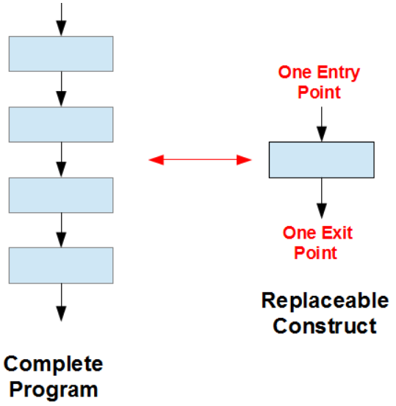
1. Structured Programming
Structure of a program code should be organize in a manner so that it is understandable, testable and readily modifiable.
It consists of simple logical constructs, each of which has one entry point and one exit point.
The beginning step for developing a program is DESIGN using
Pseudo-coding or
Flow charting

Slide 8
Structured Programming - Pseudo-code
Pseudo-code is a set of shorthand notes in a human (non-programming) language that itemizes the key steps in the sequence of instructions that produce a programming solution.
Example 1: Calculating the absolute value of an integer inputted from the keyboard.
Prompt the user for an integer value Accept an integer value from the user and store it in x If x is negative then x = -x Display x

Slide 9
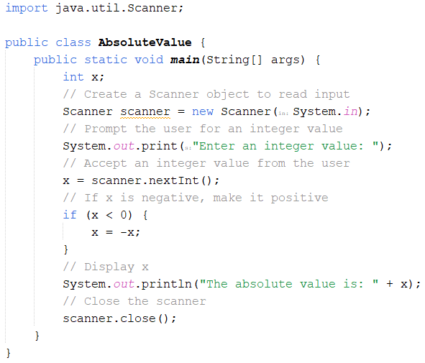
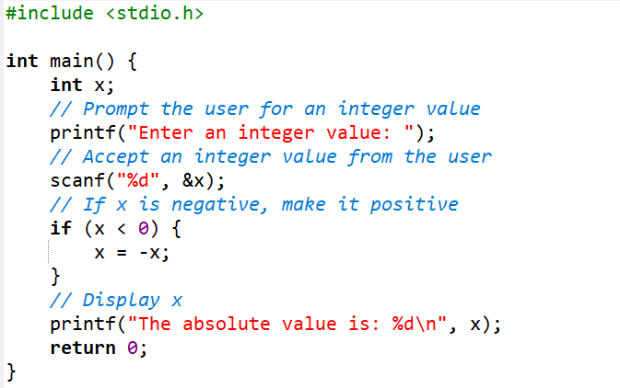
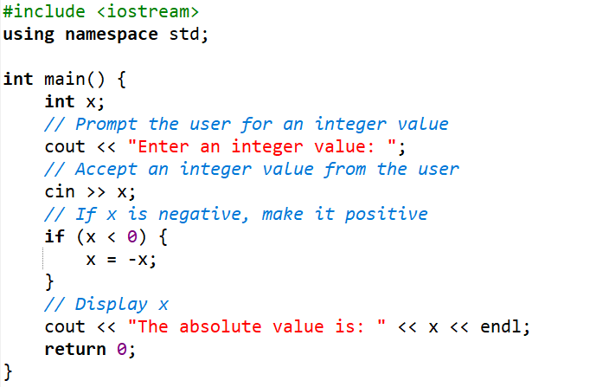
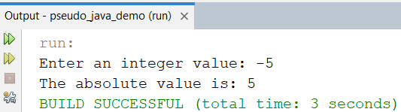
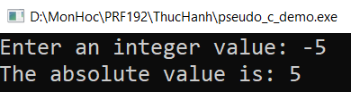
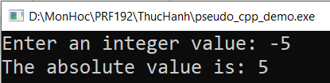
Pseudo-code → a program
Prompt the user for an integer value Accept an integer value from the user and store it in x If x is negative then x = -x Display x
Java
C
C++

Slide 10
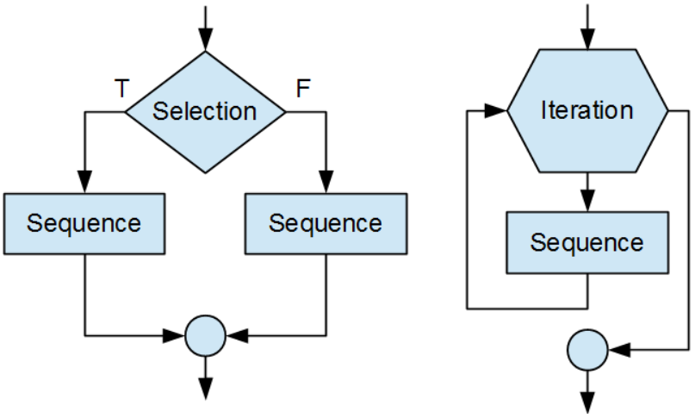
Structured Programming – flowcharting
A flow chart is a set of conventional symbols connected by arrows that illustrate the flow of control through a programming solution. Popular sets of symbols for sequences, selections and iterations are shown below:

Slide 11
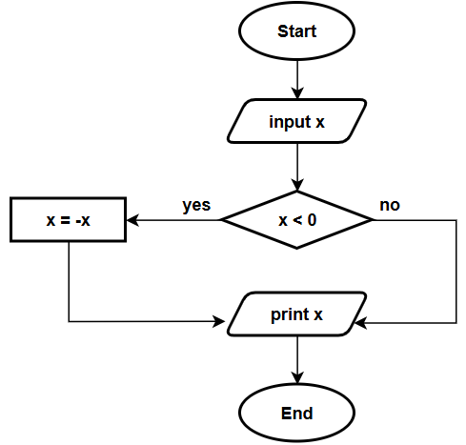
Flowchart - Example
Calculating the absolute value of an integer inputted from the keyboard.
C
C++

Slide 12

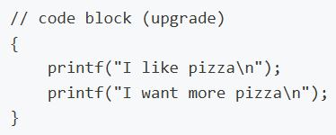
2. Sequence Contructs
A sequence is either a simple statement or a code block.
Simple Statements | Syntax: | Example:
 | Expression;
Code Block (A code block is a set of statements enclosed in curly braces) | Syntax: | Example:
 | { statement ... statement }

Slide 13
3. Selection Constructs
Select 1/2 | Select 1/n
if if … else If … else if …. else ? : (operator) | switch
Condition ?
Integral
expression
TRUE
FALSE
c1
c2
c3
default
Operation 1
Operation 2
Op1
Op2
Op3
Op4

Slide 14
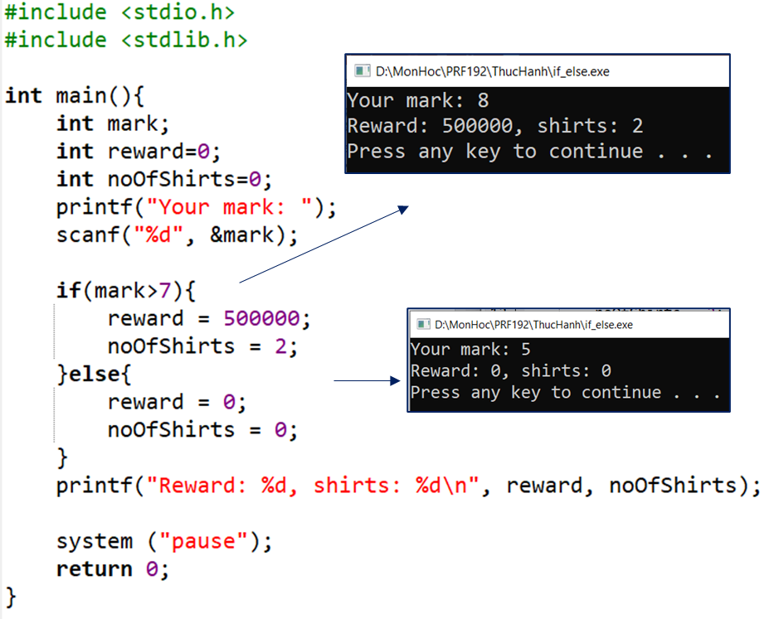
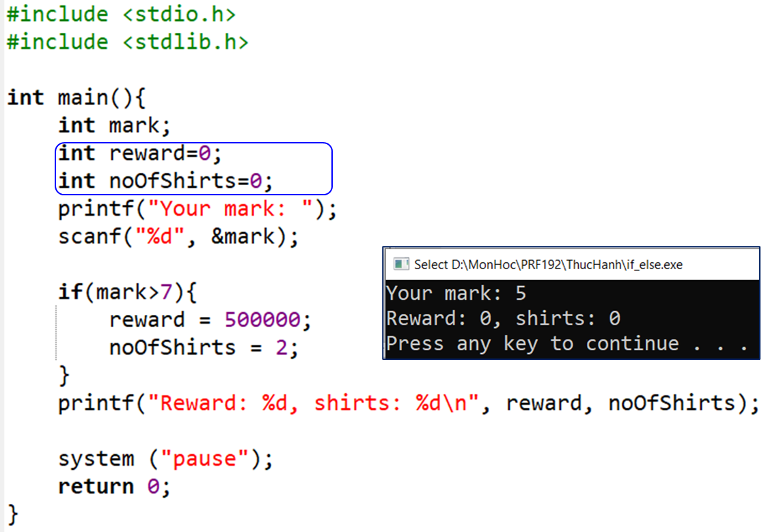
Selection Constructs - if … else
Syntax:
if (condition)
{
statements
}
Syntax:
if (condition)
{
statements
}
else
{
statements
}

Slide 15
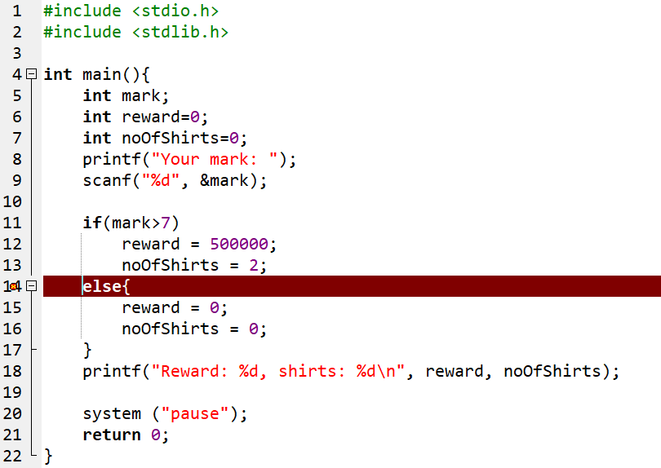
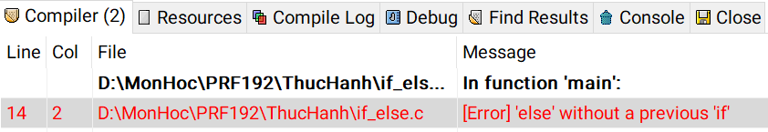
Selection Constructs - if … else (cont.)
Syntax:
if (condition)
{
statements
}
else
{
statements
}
The compiler can not determine the if statement before the else statement.

Slide 16
Selection Constructs - if … else (cont.)
Syntax:
if (condition 1)
{
statements
}
else if (condition2)
{
statements
}
else
{
statements
}
Example 1:
Buying N T-shirts with promotion:
N<=3: 120000$/item
From 4th to 6th: 90000$/item
From 7th to 10th: 85000$/item
From 11th : 70000$/item
Describe the expression that will compute the paid value.
Begin
N,t → int
Accept N
Compute t
Print out t
End
Let N: number of T-shirts bought, t: money must be paid.
if (N <=3) t = N*120000 ;
else if (N<=6) t= 3*120000 + (N-3) * 90000;
else if (N<=10)
t= 3*120000 + 3*90000 + (N-6)*85000;
else
t= 3*120000 + 3*90000 + 4*85000 + (N-10)*70000;
Nested if

Slide 17
Selection Constructs - if … else (cont.)
Practice 1:
Similarly, describe the expression that will compute the paid value when we use electric power.
Implement it to a program.
Begin
N,t → int
Accept N
Compute t
Print out t
End
Number of kwhs
100
150
200
950
1250
1350
1550
prices

Slide 18
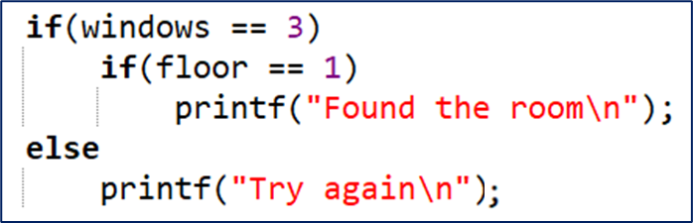
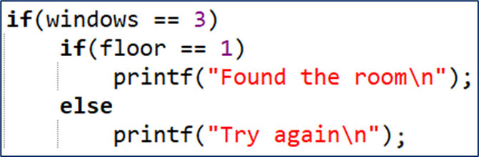
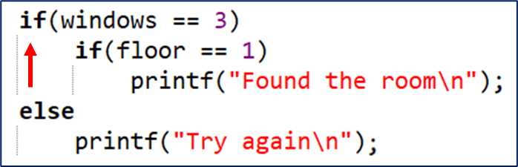
Selection Constructs - Dangling Else
Ambiguity may arise in the case of nested if else constructs
To which if does the else belong?
Which interpretation?
or

Slide 19
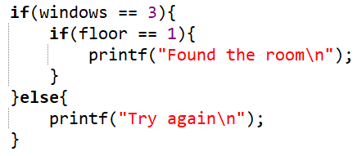
Selection Constructs - Dangling Else (cont.)
The rule in C is that an else always belong to the innermost if avariable. Use { } to explicitly determine statements.
Solution:

Slide 20
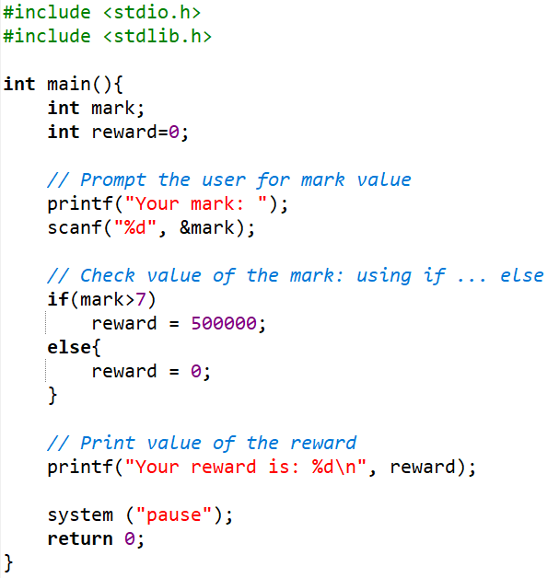
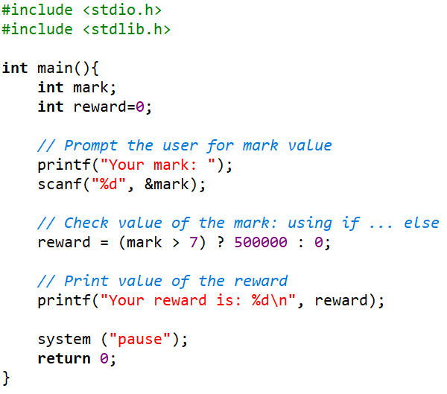
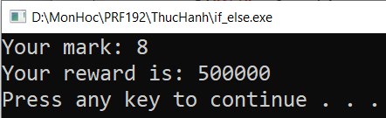
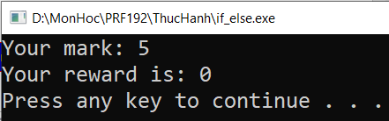
Selection Constructs - Operator ? :
Syntax: (condition) ? True_Value : False_Value
Using if … else
Case 1: mark > 7
Case 2: mark < 7

Slide 21
Selection Constructs - The switch statement
switch (variable or expression)
{
case constant :
statement(s);
break;
case constant :
statement (s);
break;
default:
statement (s);
}
Integral
expression
char / int
c1
c2
c3
default
Op1
Op2
Op3
Op4
If the break statement is missed, the next statements
are executed until a break is detected
or all statements in the body of the switch are executed.
Each case is an entry of a selection

Slide 22
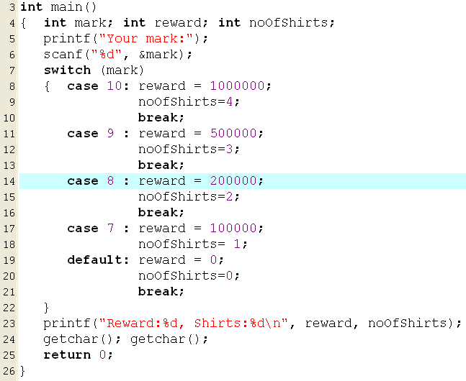
Selection Constructs - The switch statement (cont.)
Example:
If input is 8, what are outputs?
200000 , 2
300000, 3
0, 0
1000000, 4
1500000, 10
None of the others
If input is 7, what are outputs?

Slide 23
The switch statement (cont.)
Analysis
Nouns: expression num1 op num2
➔ double num1, num2; char op
result → double result
Verbs: Begin
Accept num1, op, num2 → “%lf%c%lf”
switch (op)
{ case ‘+’ : result = num1 + num2;
print out result;
break;
case ‘-’ : result = num1 - num2;
print out result;
break;
case ‘*’ : result = num1 * num2;
print out result;
break;
case ‘/’ : if ( num2==0)
print out “Divide by 0 “
else
{ result = num1 / num2;
print out result;
}
break;
default: print out “Op is not supported”
}
End
Practice 2:
Write a program that allows user inputting a simple expression containing one of four operators +, -, *, / then the result is printed out to the monitor. Input format:
num1 operator num2,
Example: 4*5
Implement it.

Slide 24
4. Iteration (loop) Constructs
Loop/Iteration: some statements are executed repetitively
Structure of a loop:
Initial block.
Condition.
Task in each execution.
Types of iteration: fixed loops, variable loops
The iteration constructs are:
while
do while
for

Slide 25
Iteration Constructs (cont.)
Identify a loop:
Calculate S= 1 + 2 + 3 + 4 + 5 + 6 + 7 + … + 100
Some addition are performed ➔ Loop
Sum of some numbers they are inputted until user enters 0.
Accept and add numbers ➔ Loop

Slide 26
Iteration Constructs (cont.)
Identify a loop for an expression:
Left side → Initial block
Right side → Condition
An operation and preparations for the next iteration: Tasks in each iteration.
S=1+2+3+4+… + 100
→ S=0+1+2+3+4+… + 100
S=1*2*3*4*… * 100
→S=1*1*2*3*4*… * 100
S=0
(1) S=S+i;
(2) i=i+1;
i<=100
S=1
(1) S=S*i;
(2) i=i+1;
i<=100
i=1
i=1
S=1
i=2

Slide 27
Iteration Constructs (cont.)
S= 0 , n<=0
n + (n-2) + (n-4) + … + 0
S= 0 , n<=0
1 + 3 + 5 +… + n, n is odd
2 + 4 + 6 + … + n, n is even
Initial value:
S = 0;
i = n;
Condition i>0
Tasks: S += i;
i -=2;
Initial value:
S = 0
i = (n%2==1)? 1: 2;
Condition i <=n
Tasks: S += i;
i+=2;
S= 1 + 1/1⁰ + 1/ 2¹ + 1/3² + … + 1 /n^{n-1}
Initial value:
S = 1.0;
i = 1;
Condition i <=n
Tasks: S += 1.0/ pow ( i, i-1 );
i = i +1;
math.h

Slide 28
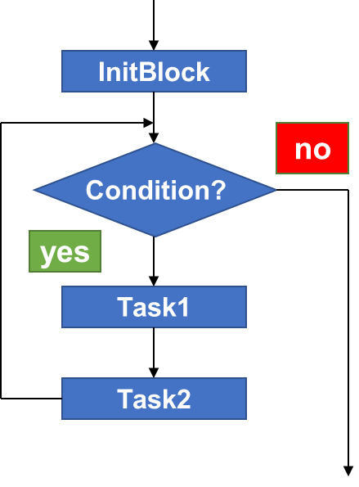
Iteration - for statement
for ( InitBlock; Condition ; Task2) Task1;
for ( Init1, Init2; Condition ; Task1, Task2);
InitBlock;
for ( ; Condition ; Task2) Task1;
InitBlock;
for ( ; Condition ;)
{
Task1;
Task2;
}

Slide 29
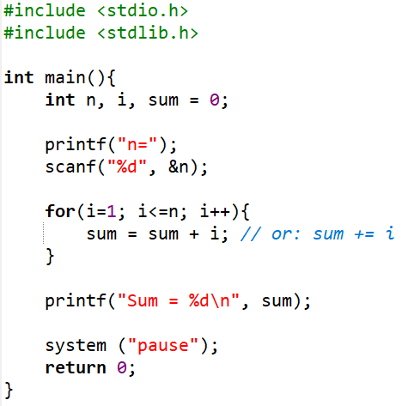
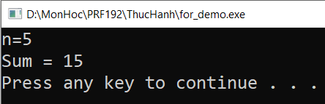
Iteration - for statement (cont.)
Example: Write a program that will calculate 1+2+3+…+n.
Accepted variable: int n
Sum 1 .. N → int sum
Algorithm
Accept n
Loop:
Initialize i=1, sum=0
Condition i<=n
Tasks: sum += i; i++;
Print out sum
Requirement: Students practice other structures of for and give feedback.

Slide 30
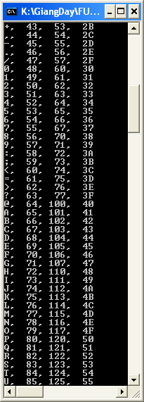
Iteration - for statement
Practice 3:
Write a program that will print out the ASCII table.
Analysis:
ASCII code : 0 → 255
Initialize: int code =0
Condition: code <256
Task:
Print the code using 4 format: %c, %d, %o, %X
code = code +1

Slide 31
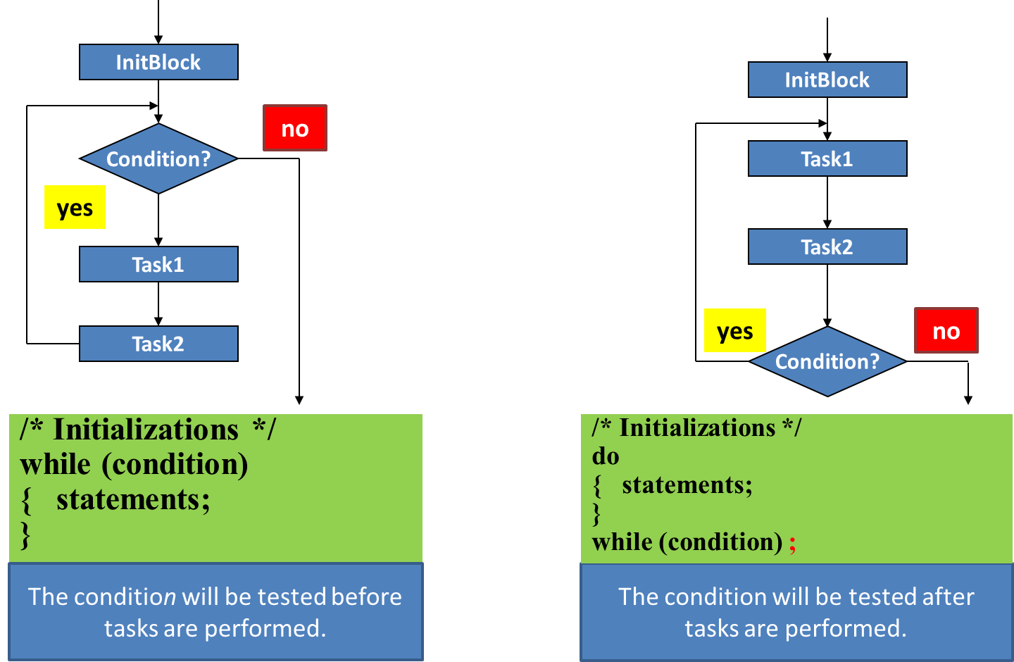
Iteration - while/ do … while statements

Slide 32
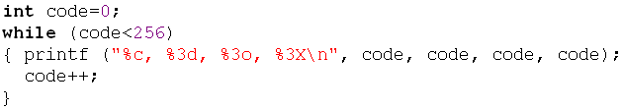
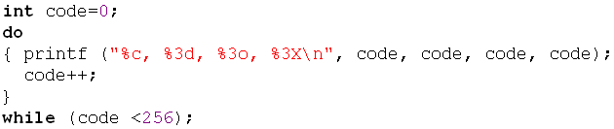
Iteration - while/ do … while statements
Practice 4:
Write a program that will print out the ASCII table.
Analysis:
ASCII code : 0 → 255
Initialize: int code =0
Condition: code <256
Task:
Print the code using 4 format: %c, %d, %o, %X
code = code +1

Slide 33
Iteration - Exercise 1
Write a program that will print out the sum of integers inputted by user. The input will terminate if user enters the value 0.
Nouns: inputted integer → int x,
sum of integers → int sum
Tasks (algorithm)
Begin
sum =0
do
{ accept x;
sum += x;
}
while (x!=0);
Print out sum
End
Implement it by yourself.

Slide 34
Iteration - Exercise 2
Implement it by yourself.
Write a program that permits user entering some characters until the ENTER key (code 10) is pressed. The program will print out the number of digits, number of letters, number of other keys were pressed. Accept a character: c=getchar();
Nouns:
character inputted → char c, Number of digits → int noDigits
Number of letters → noLetters, Number of other keys → noOthers
#define ENTER 10
Algorithm
Begin
noDigits = noLetters = noOthers = c= 0
printf(“Enter a string:”);
While (c!=ENTER)
{ accept c;
if ( c>=‘0’ && c <=‘9’) noDigits++;
else if ( (c>=‘a’ && c <=‘z’) || (c>=‘A’ && c <=‘Z’) ) noLetters++;
else noOthers++;
}
Print out noDigits, noLetters, noOthers
End
The while statement is intentionally used. So, c=0 is assigned and the condition c!=ENTER is evaluated to TRUE
Input form:
abc1234fGH+-*/?(ENTER)

Slide 35
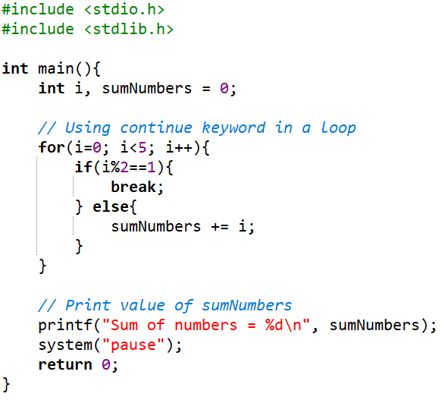
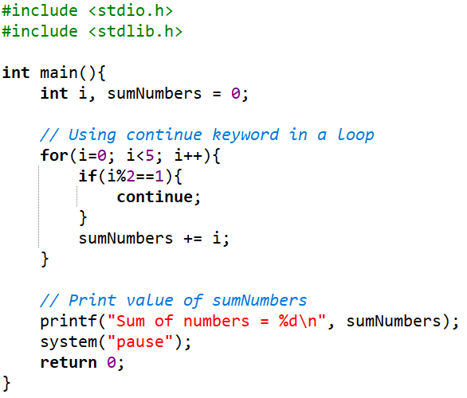


Iteration - break/ bypass a loop
Example: break
Example: continue
0 1 2 3 4 5
0 1 2 3 4 5

Slide 36
Iteration Constructs: Flags
The one entry, one exit principle is fundamental to structured programming.
C includes three keywords that allow jumps across statements: goto, continue, and break. Using any of these keywords, except for break in a switch construct, violates the one entry, one exit principle of structured programming.

Slide 37
Iteration Constructs: Flags (cont.)
To improve readability, programmers advocated:
The use of whitespace to identify the logical structure of the code
The abolition of all goto statements
The abolition of all continue statements
The abolition of all break statements, except with switch
A technique for avoiding jumps is called flagging. A flag is a variable that keeps track of a true or false state.

Slide 38
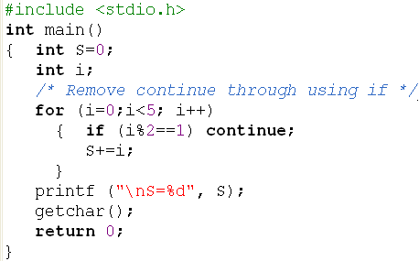
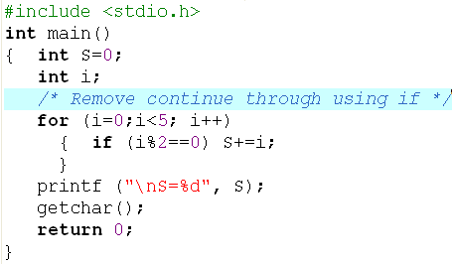

Iteration Constructs: Flags (cont.)
Use if instead of continue
Example:

Slide 39
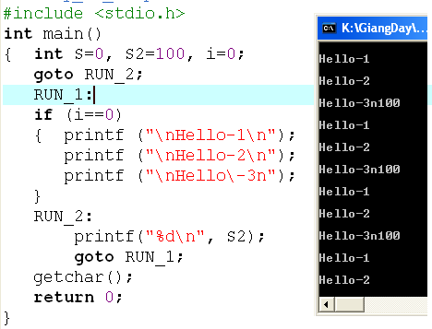
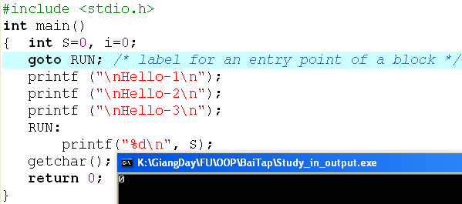
Iteration Constructs: Flags (cont)
Example: using goto
Loop infinitively

Slide 40
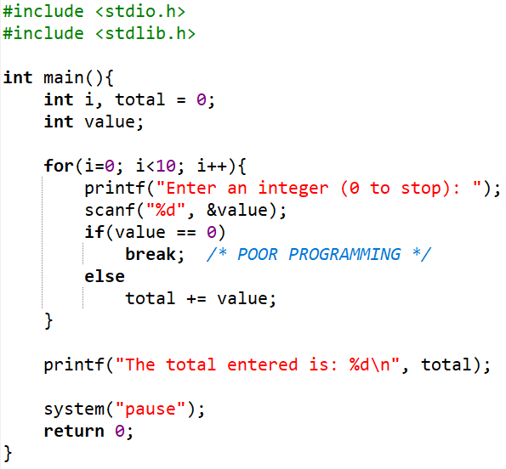
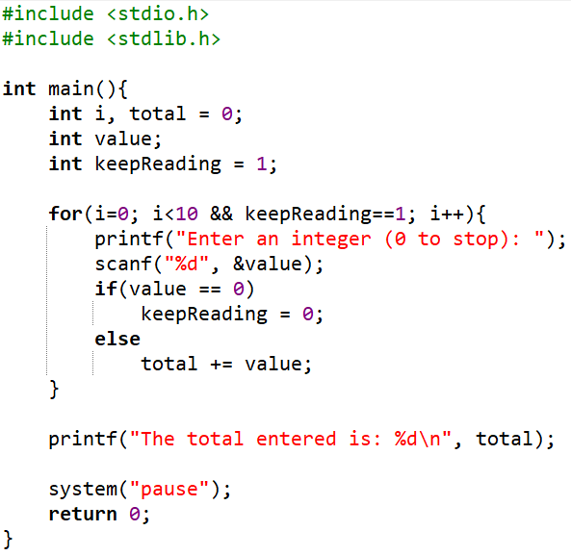
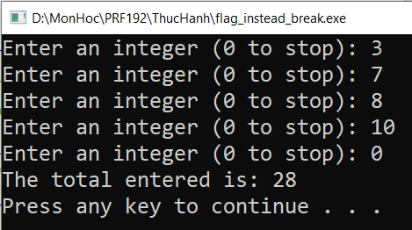
Iteration Construct: Flags (cont.)
Use a flag instead of break
A flag is used.
No flag is used.
Same output:

Slide 41
Programming Styles

Slide 42
Habits in programming
A well-written program is a pleasure to read. Other programmers can understand it without significant effort. The coding style is consistent and clear throughout.
Develop your own style guide or adopt the style outlined here or elsewhere, but adopt some style.
Recommendations on
Naming
Indentation
Comments
General Guidelines

Slide 43
Programming Stytes: Naming
Adopt names that are self-descriptive so that comments clarifying their meaning are unnecessary
Use names that describe identifiers completely, avoiding cryptic names
Prefer nouns for variable names
Keep variable names short - studentName rather than theNameOfAStudent → (Camel case rule)
Keep the names of indices very short - treat them as mathematical notation

Slide 44
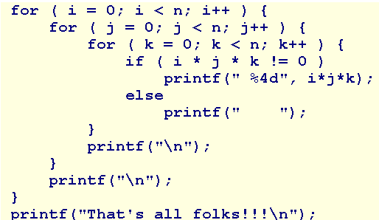
Programming Styles: Indentation
Indent the body of any construct that is embedded within another construct.
For example:
Note: Use in-line opening braces or start opening braces on a newline but don't mix the two styles.

Slide 45
Programming Styles: Comment
Use comments to declare what is done, rather than describe how it is done.
Comments introduce what follows.
Keep them brief and avoid decoration.

Slide 46
Programming Styles: Guidelines
Limit line length to 80 characters - both comments and code
Avoid global variables
Select data types for variables wisely and carefully
Initialize a variable when declaring it only if the initial value is part of the semantic of the variable.
If the initial value is part of an algorithm, use a separate assignment statement.
Avoid goto, continue, break except in switch.
Avoid using the character encodings for a particular machine.
Use a single space or no spaces either side of an operator.

Slide 47
Programming Styles: Guidelines
Use in-line opening braces or start opening braces on a newline but don't mix the two styles.
Initialize iteration variables in the context of the iteration
Avoid assignments nested inside logical expressions
Avoid iterations with empty bodies - reserve the body for the algorithm
Limit the initialization and iteration clauses of a for statement to the iteration variables
Distribute and nest complexity

Slide 48
Programming Styles: Guidelines
Avoid fancy algorithms that may be efficient but are difficult to read
Add additional comments where code has been fine tuned for efficient execution
Add an extra pair of parentheses where an assignment is also used as a condition
Remove unreferenced variables
Remove all commented code and debugging statements from release and production code

Slide 49
Walkthroughs

Slide 50
Walkthroughs
Understand code is a skill of programmer.
To understand code, we should know how the code execute.
To know how the code execute, we should perform each instruction.
A walkthrough is
A record of the changes that occur in the values of program variables as a program executes and
A listing of the output, if any, produced by the program.
Ways to perform a walkthrough
Memory Map → You knew that
Walkthrough Tables → A simpler way
Debug a program
What is debugging?
Why use debugging?

Slide 51
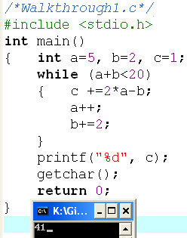
Walkthroughs (cont.)
Example 1:
a | b | a+b | c
5 | 2 | 7 | 1
6 | 4 | 10 | 9
7 | 6 | 13 | 17
8 | 8 | 18 | 25
9 | 10 | 19 | 33
10 | 12 | 22 | 41
Output
41

Slide 52
Walkthroughs (cont.)
Example 2:
int n, i, S=0;
scanf(“%d”, &n);
for (i=1; i<=n; i+=3)
if (i%2!=0 && i%3!=0) S+=i;
printf(“%d”, S);
What is the output if the input is 15?
n | 15
i | 1 | 4 | 7 | 10 | 13 | 16
S | 0+1 → 1 |  | 1+7 → 8 |  | 8+13→21
S=21

Slide 53
Walkthroughs - Exercise
int m,n, i, S=0;
scanf(“%d%d”, &n, &m);
for (i=m; i<=n; i++) S+=i;
printf(“%d”, S);
What is the output if the input are 8 12?
Modify | Input
“%d %d” | 12 8
“%d%d” | 12 8
“%d%d” | 12 8
“%d-%d” | 12-8
Test the program:
int m,n, i, S=0;
scanf(“%da%d”, &n, &m);
for (i=m; i<=n; i++) S+=i;
printf(“%d”, S);
What is the output if the input are 8a12?

Slide 54
Debug a program
What is debugging?
Debugging is the process of identifying, analyzing, and fixing errors (or bugs) in the source code of a program.
Why use debugging?
To identify and fix errors
To save time and effort
To understand program behavior
To improve software quality
To prevent future issues
Notes:
To Identify and Fix Errors:
Debugging helps locate the root cause of errors or unexpected behaviors in your code.
Bugs can cause crashes, incorrect outputs, or inefficient performance, which debugging aims to resolve.
To Save Time and Effort:
Debugging tools provide efficient ways to inspect and track the state of the program in real-time, allowing developers to fix issues faster compared to manually scanning the code.
To Understand Program Behavior:
Debugging allows developers to step through their code line by line, making it easier to understand how data flows and how logic is executed within the program.
To Improve Software Quality:
By identifying and fixing bugs, debugging ensures the software is reliable, performs well, and meets user expectations.
To Prevent Future Issues:
Debugging helps uncover potential flaws in code logic or design that might cause problems later, ensuring a more robust application.

Slide 55
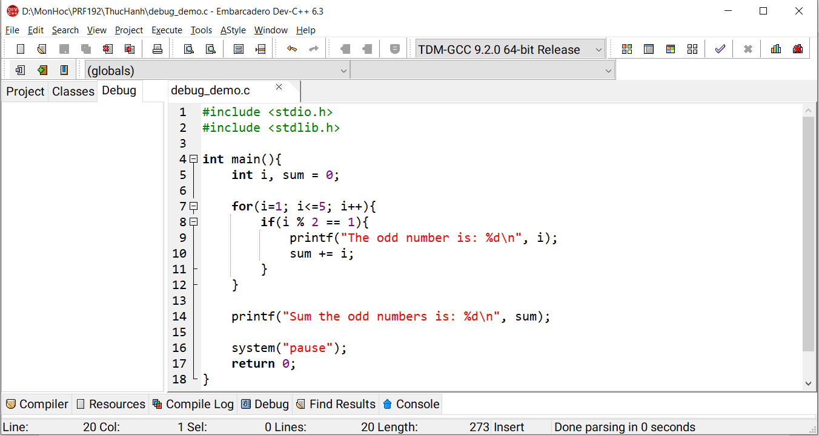
How to debug a simple program? (using Dev-C++)
Step 1: Write Your Code

Slide 56
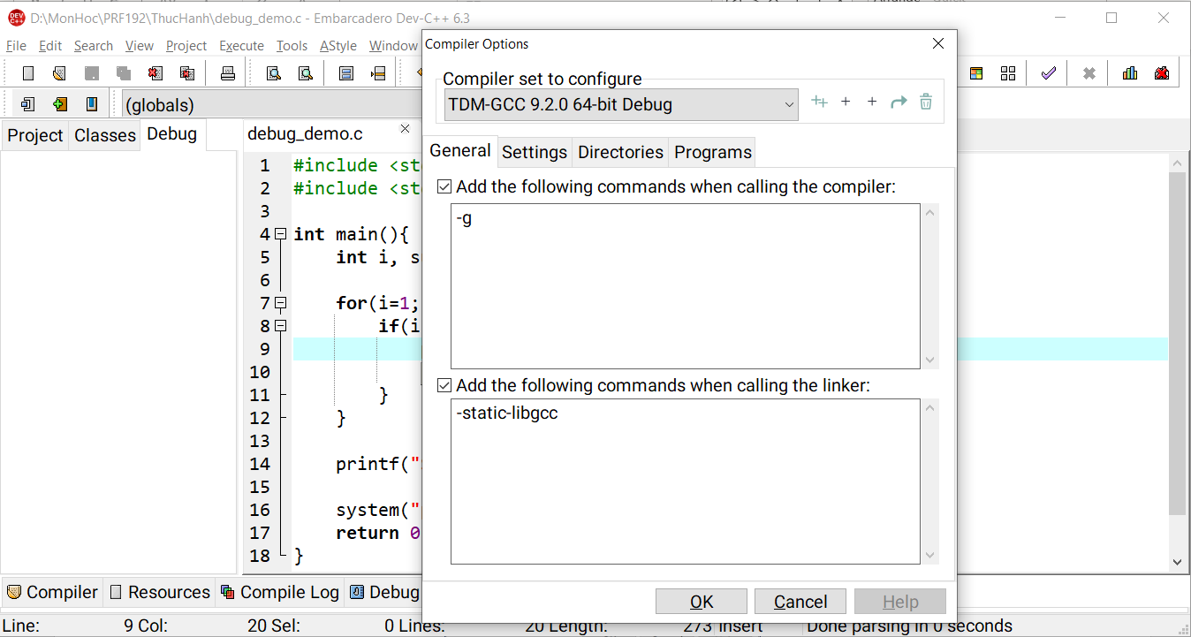
How to debug a simple program? (cont.)
Step 2: Enable Debugging
Go to Tools → Compiler Options → Change the configuration as follows:
1
2
3

Slide 57
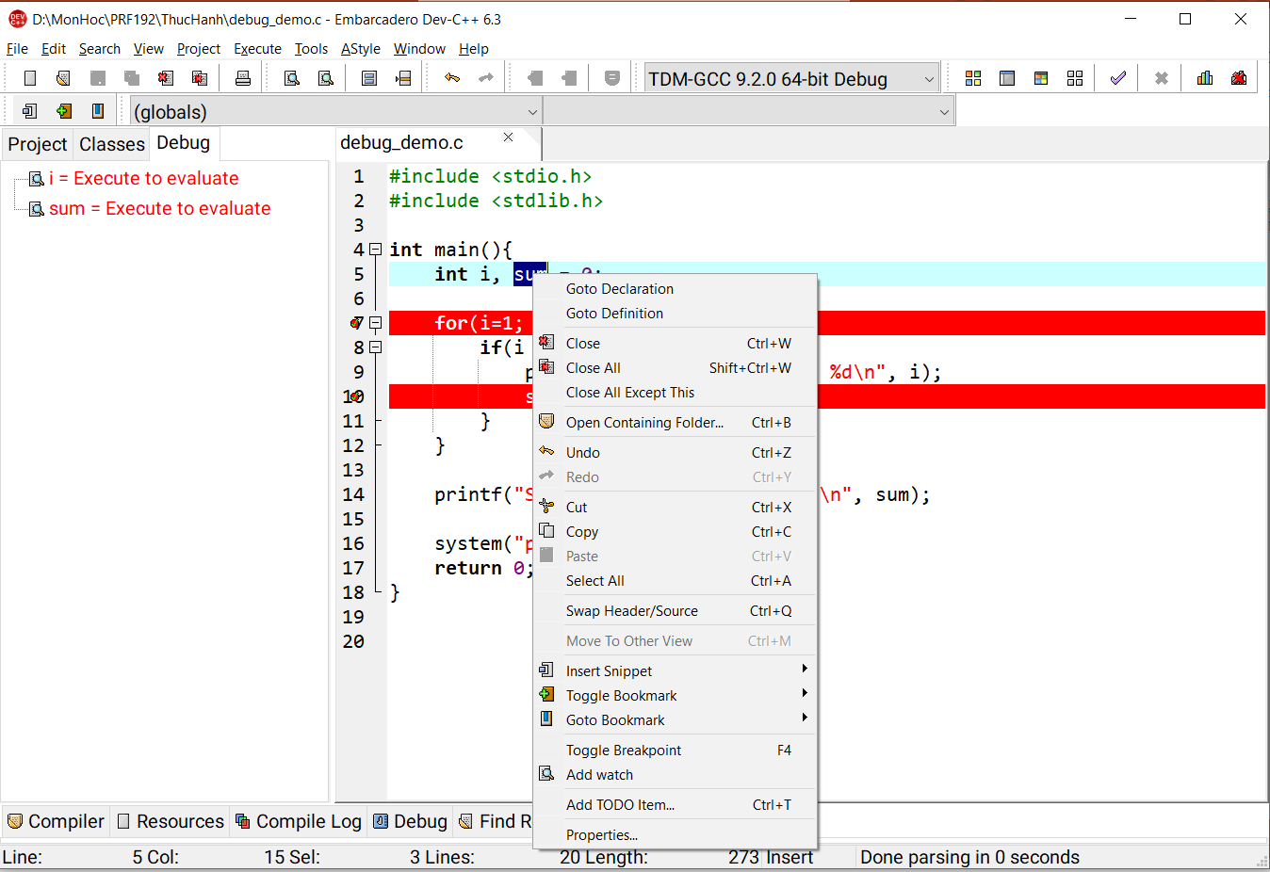
How to debug a simple program? (cont.)
Step 3:
Set Breakpoints: To set a breakpoint, click on the margin (left of the line numbers) next to the line of code where you want the program to pause → A red dot will appear, indicating the breakpoint.
Add watch: To watch the changes of each variable → Right click on the variable → Add watch
1
2

Slide 58
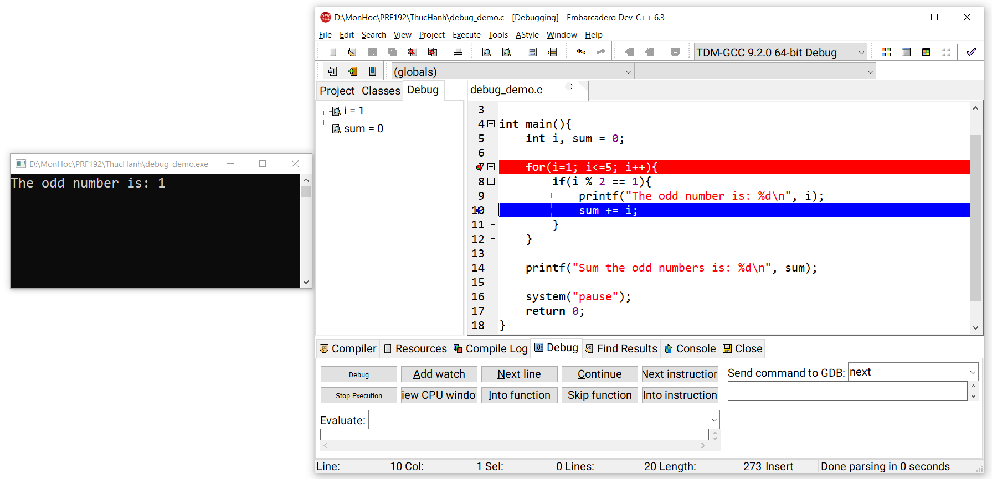
How to debug a simple program? (cont.)
Step 4: Run the Debugger
Go to Execute → Debug (or Debug icon on Toolbar) → Next Line (or F7)
1
Output:
watch
2

Slide 59
Exercise
Explain the types of errors in the program?
Syntax Errors
Logical Errors
Runtime Errors
Semantic Errors
Write a simple program with the types of errors that are likely to occur. Also, use the Dev-C++ debugger to debug and revise the program.

Slide 60
Summary (cont.)
Logic constructs = Statements can be used in a program.
3 basic constructs:
Sequence,
selection constructs (if, if…else, ?:, switch),
Iteration constructs (for/ while/ do … while)
Walkthrough: Code are executed by yourself, Tasks in a walkthrough: a record of the changes that occur in the values of program variables and listing of the output, if any, produced by the program. Debug & Fix code in the program.

